Slide 1

数字音频基础 Basics of Digital Audio
授课教师：张小燕
邮箱：xyzhang15@szu.edu.cn
2021年春季课程

Slide 2
Outline of Lecture 05
Digitization of Sound
Sound and Digitization
Nyquist Theorem
Signal to Noise Ratio (SNR)
Quantization and Transmission of Audio
Experiments

Slide 3
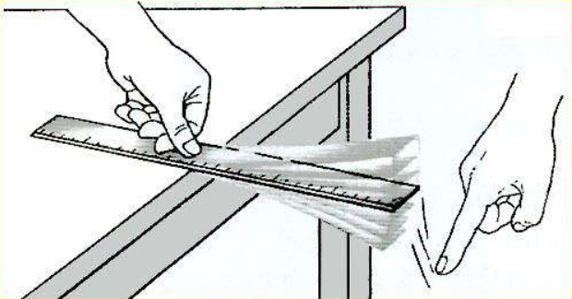
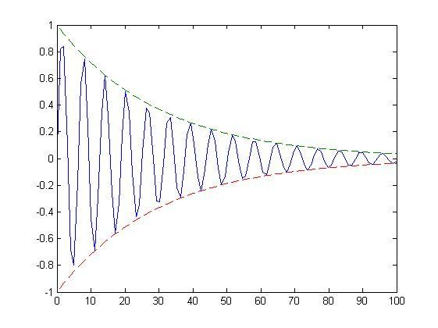
Sound and Digitization
What is Sound?
Sound （声音）is a wave phenomenon like light, but is macroscopic and involves molecules of air being compressed and expanded under the action of some physical device.
Sound is a pressure wave that moves through a compressible (可压缩的) medium
Characteristics of sound
Amplitude （振幅）
Measure the pressure at a location using voltage levels（电平）
Frequency
The number of periodic vibrations (震动) within a second

Slide 4
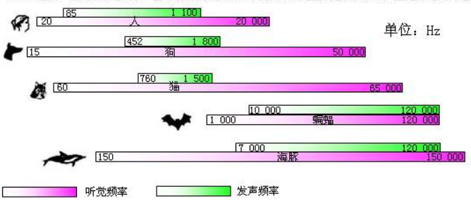
Sound and Digitization
What is Sound?
Frequency ranges of human and animals.

Slide 5
Sound and Digitization
Audio （音频）is the sounds human can hear
Frequency response
20Hz-20kHz for human hearing
Human are more sensitive to low frequencies
Speech （语音）is the sounds human can utter （说出）
85HZ to 1,100HZ
A human adjusts himself/herself very efficiently to different speakers and their speech habits
Notes:
高于20KHz叫做超声

Slide 6
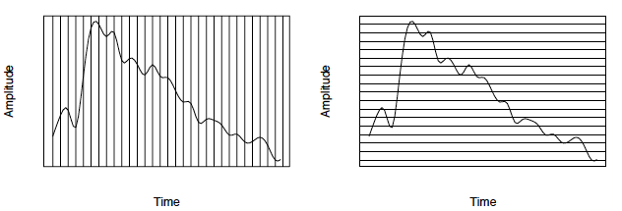
Sound and Digitization
The signal is digitized in each dimension: in time and in amplitude
Sampling
Convert continuous time into discrete time domain
Typical sampling rate of audio: 8KHZ ~ 48KHZ
Quantization
Convert continuous sample values into discrete values

Slide 7
Sound and Digitization
Digitization
Thus to decide how to digitize audio data we need to answer the following questions:
What is the sampling rate?
How finely is the data to be quantized, and is quantization uniform?
How is audio data formatted? (file format)

Slide 8
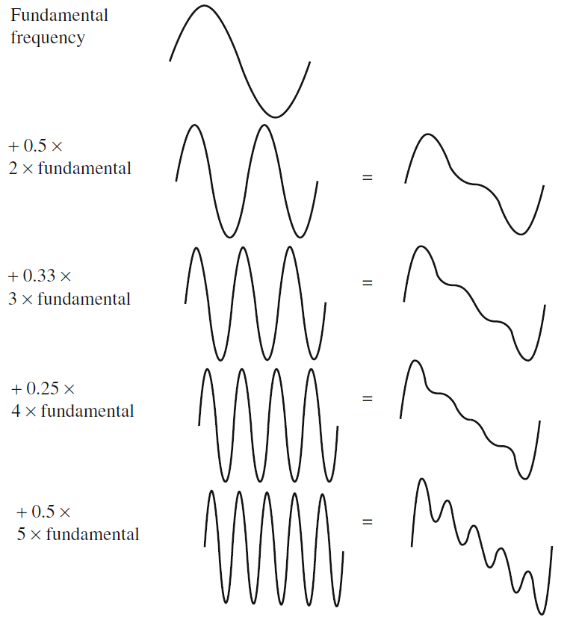
Nyquist Theorem
Complex signal by superposing sinusoids

Slide 9
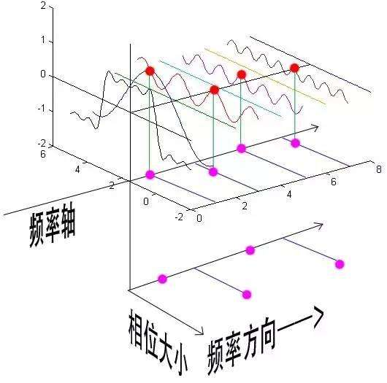
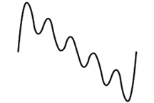
Nyquist Theorem
Signals can be decomposed into a sum of sinusoids.
Whereas frequency is an absolute measure, pitch(音高/音调) is generally relative - a perceptual subjective quality of sound.
Fourier transformation: Extract information of each components
https://zhuanlan.zhihu.com/p/19763358
Notes:
Pitch and frequency are linked by setting the note A above middle C to exactly 440 Hz.
声音的属性（即响度、音调、音色）之一,声音的品质叫做音色，又叫音品，它反映了每个物体发出的声音特有的品质

Slide 10
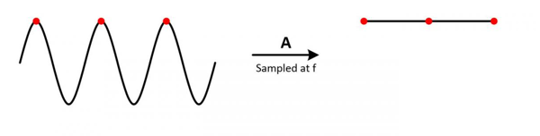
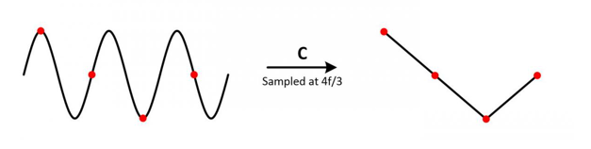
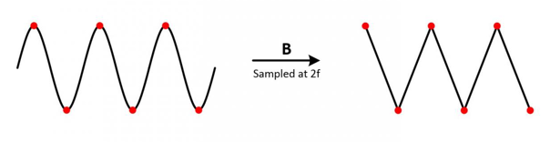
Nyquist Theorem
Nyquist Theorem（奈奎斯特理论）
The Nyquist theorem states how frequently we must sample in time to be able to recover the original sound.

Slide 11
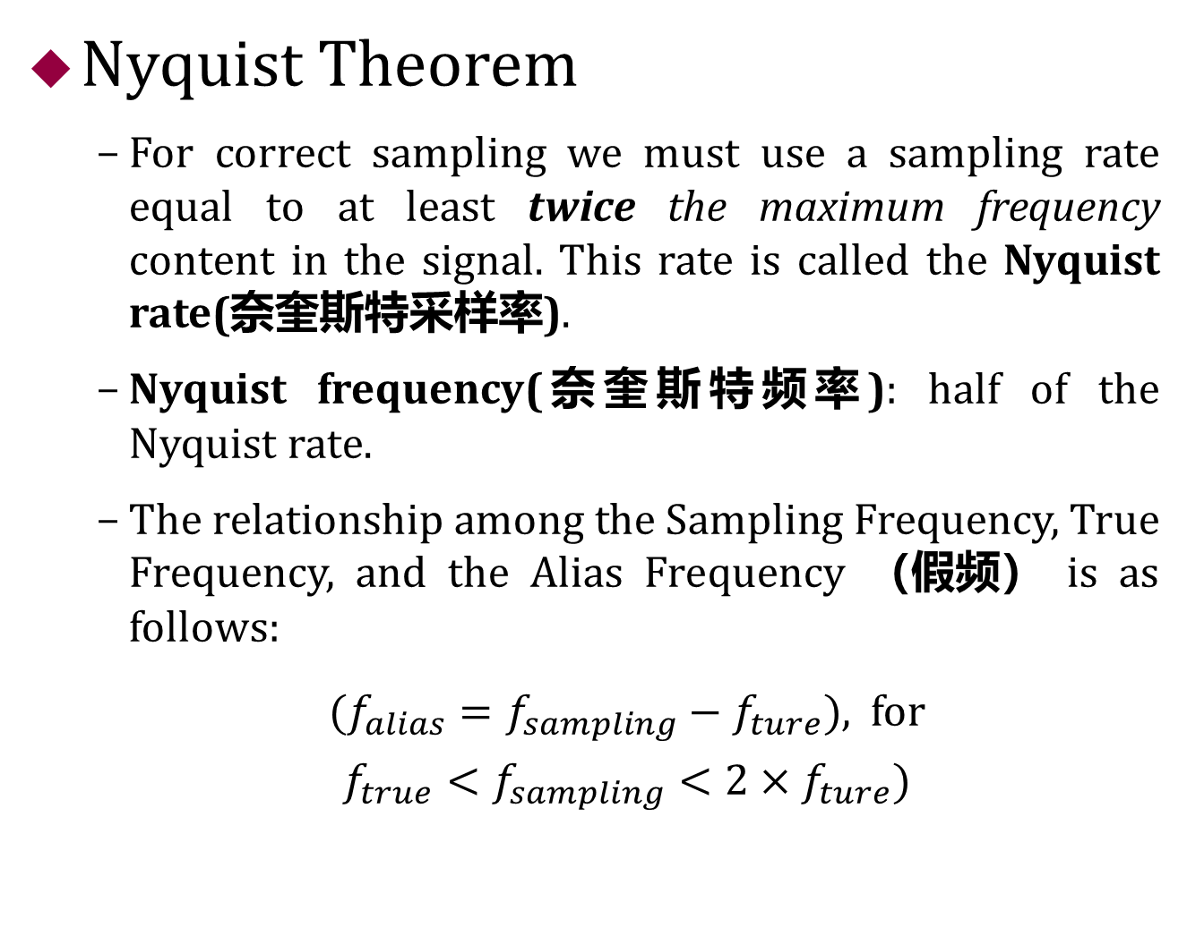
Nyquist Theorem
Nyquist Theorem
For correct sampling we must use a sampling rate equal to at least twice the maximum frequency content in the signal. This rate is called the Nyquist rate(奈奎斯特采样率).
Nyquist frequency(奈奎斯特频率): half of the Nyquist rate.
The relationship among the Sampling Frequency, True Frequency, and the Alias Frequency （假频） is as follows:
${(f_{alias}=f_{sampling}−f}_{ture})$, for ${f_{true}<f_{sampling}<2×f}_{ture})$
Notes:
虽然可以按高于最高频率的2倍进行奈奎斯特采样。
但是，很快就会发现当最高频率远远大于信号带宽B时，如果按照奈奎斯特采样率来采样，则其采样率会非常高，但是其信号带宽并不一定很宽，现实中的A/D难以实现的。这时，低通采样定理已经不能满足实际中的使用要求，从而催生了带通采样的应用。

Slide 12
Nyquist Theorem
思考题
如一个声音的频率为22.05kHz，
奈奎斯特采样率应该为多少？
44.1kHz
如果采样频率为33.075kHz，则假频为多少？
假频的计算公式为f假频=f采样频率-f真实频率，因此其假频为11.025kHz.
Notes:
虽然可以按高于最高频率的2倍进行奈奎斯特采样。
但是，很快就会发现当最高频率远远大于信号带宽B时，如果按照奈奎斯特采样率来采样，则其采样率会非常高，但是其信号带宽并不一定很宽，现实中的A/D难以实现的。这时，低通采样定理已经不能满足实际中的使用要求，从而催生了带通采样的应用。

Slide 13
Signal to Noise Ratio (SNR)
The ratio of the power of the correct signal and the noise is called the signal to noise ratio (SNR)
A measure of the quality of the signal
The SNR is usually measured in decibels (dB:分贝), where 1 dB is a tenth of a bel (贝尔)
The SNR value, in units of dB, is defined in terms of base 10 logarithms of squared voltages, as follows:
SNR = 10log₁₀(v²_{signal} /v²_{noise}) = 20log₁₀(v_{signal} /v_{noise})
To know: Power — 10; Signal Voltage — 20
Notes:
信号量化噪声 ， 信噪比：信号能力与噪声能力的比，信号质量衡量标准之一
贝尔和分贝是声音级的度量单位，贝尔这一单位是以电话的发明者贝尔命名的，后来人们嫌贝尔的单位太大，又定义的一个新的单位“分贝”

Slide 14
Signal to Noise Ratio (SNR)
Magnitude （量级） Range of Audio
The levels of audio are described in terms of decibels, as a ratio to the quietest sound we are capable of hearing
Humans perceive sounds over the entire range of 120dB, the upper limit of which will be painful to humans
音量 | 相当于
0 dB | 听力的阈值
60 dB | 日常对话
70 dB | 嘈杂的餐馆
80 dB | 嘈杂的交通，工厂噪音，吸尘器
90 dB | 地铁列车，割草机
100 dB | 电锯，冲击钻
120 dB | 不舒服的阈值（摇滚音乐会，打雷）
140 dB | 痛苦的阈值
160 dB | 伤及鼓膜
Notes:
当长时间处于在高分贝声音环境时，最直接的伤害便是内耳，高音或是噪音不断冲击震荡耳蜗中的液体，令毛细胞因受到过度刺激而死亡。一个形象的比喻就是，当我们在“享受”100分贝以上的音乐时，毛细胞就像在不断受到压路机碾压的小草，慢慢死去。长此以往，负责某一频段的毛细胞受损严重后，对该频段的听力水平便会急剧下降。

Slide 15
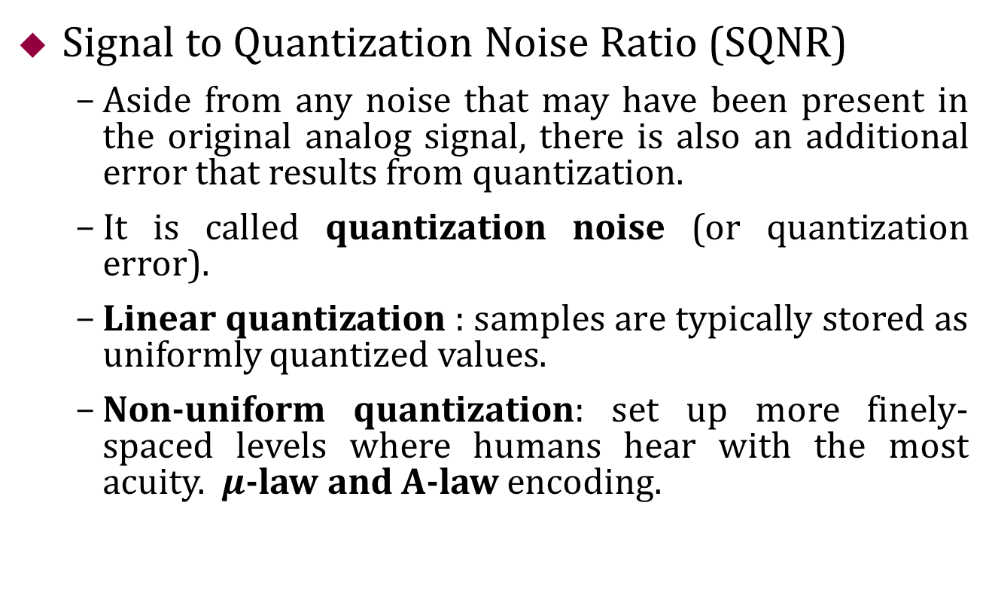
Signal to Noise Ratio (SNR)
Signal to Quantization Noise Ratio (SQNR)
Aside from any noise that may have been present in the original analog signal, there is also an additional error that results from quantization.
It is called quantization noise (or quantization error).
Linear quantization : samples are typically stored as uniformly quantized values.
Non-uniform quantization: set up more finely-spaced levels where humans hear with the most acuity.$μ$-law and A-law encoding.

Slide 16
Signal to Noise Ratio (SNR)
思考题
信号的电压为100V，噪声的电压为10V，求SNR为？
a. 10dB
b. 20dB
c. 40dB

Slide 17
Outline of Lecture 05
Digitization of Sound
Sound and Digitization
Nyquist Theorem
Signal to Noise Ratio (SNR)
Quantization and Transmission of Audio
Experiments

Slide 18
Quantization and Transmission of Audio
Coding of Audio
Quantization and transformation of data are collectively known as coding of the data.
Differences in signals between the present and a past time can reduce the size of signal values and also concentrate the histogram of pixel values (differences, now) into a much smaller range.
In general, producing quantized sampled output for audio is called PCM (Pulse Code Modulation). The differences version is called DPCM (and a crude but efficient variant is called DM). The adaptive version is called ADPCM.

Slide 19
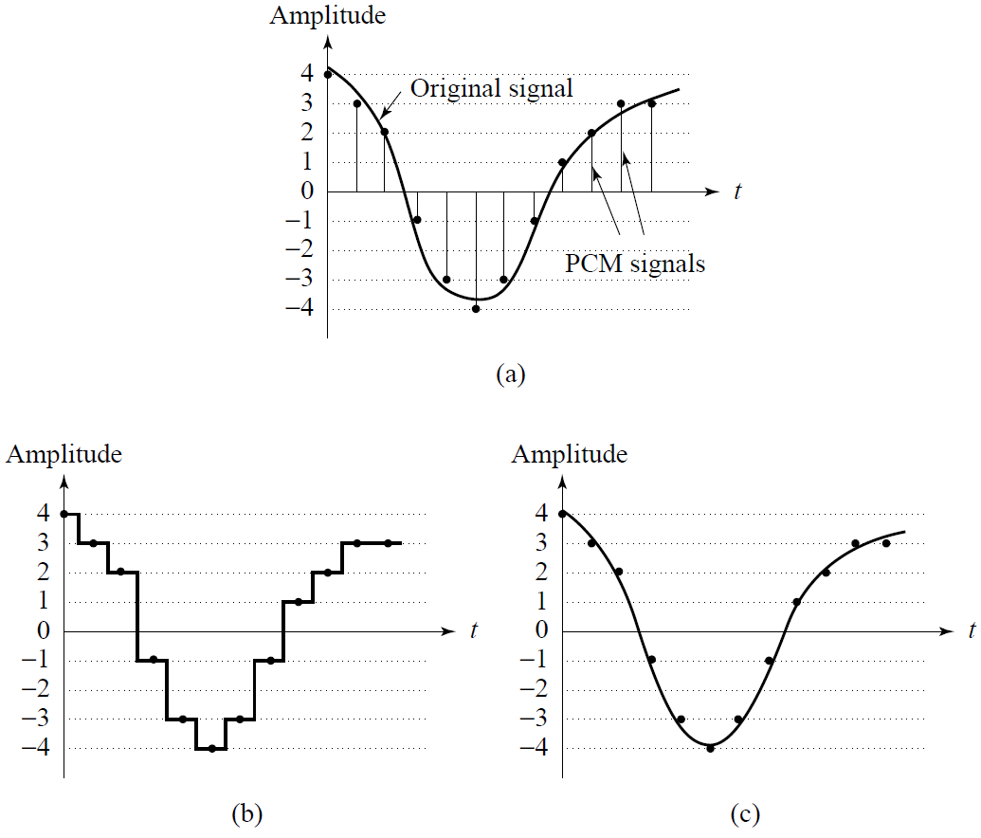
Quantization and Transmission of Audio
Pulse Code Modulation in Speech Compression
Pulse Code Modulation (PCM).
(a) Original analog signal
and its corresponding PCM signals.
(b) Decoded staircase signal. (c) Reconstructed signal after low-pass filtering.

Slide 20
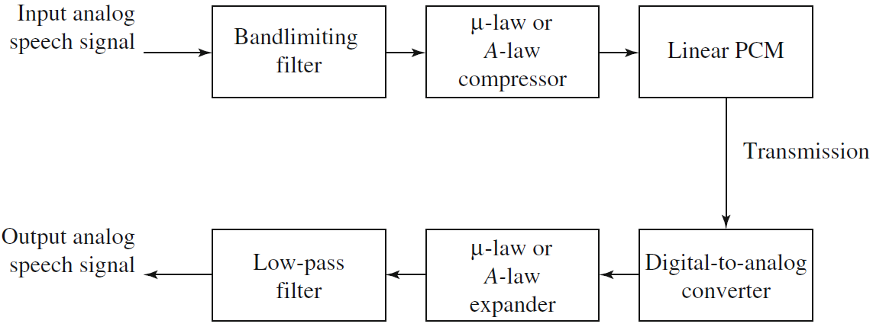
Quantization and Transmission of Audio
PCM in Speech Compression
The complete scheme for encoding and decoding telephony signals is shown as a schematic in Figure below.
PCM signal encoding and decoding

Slide 21
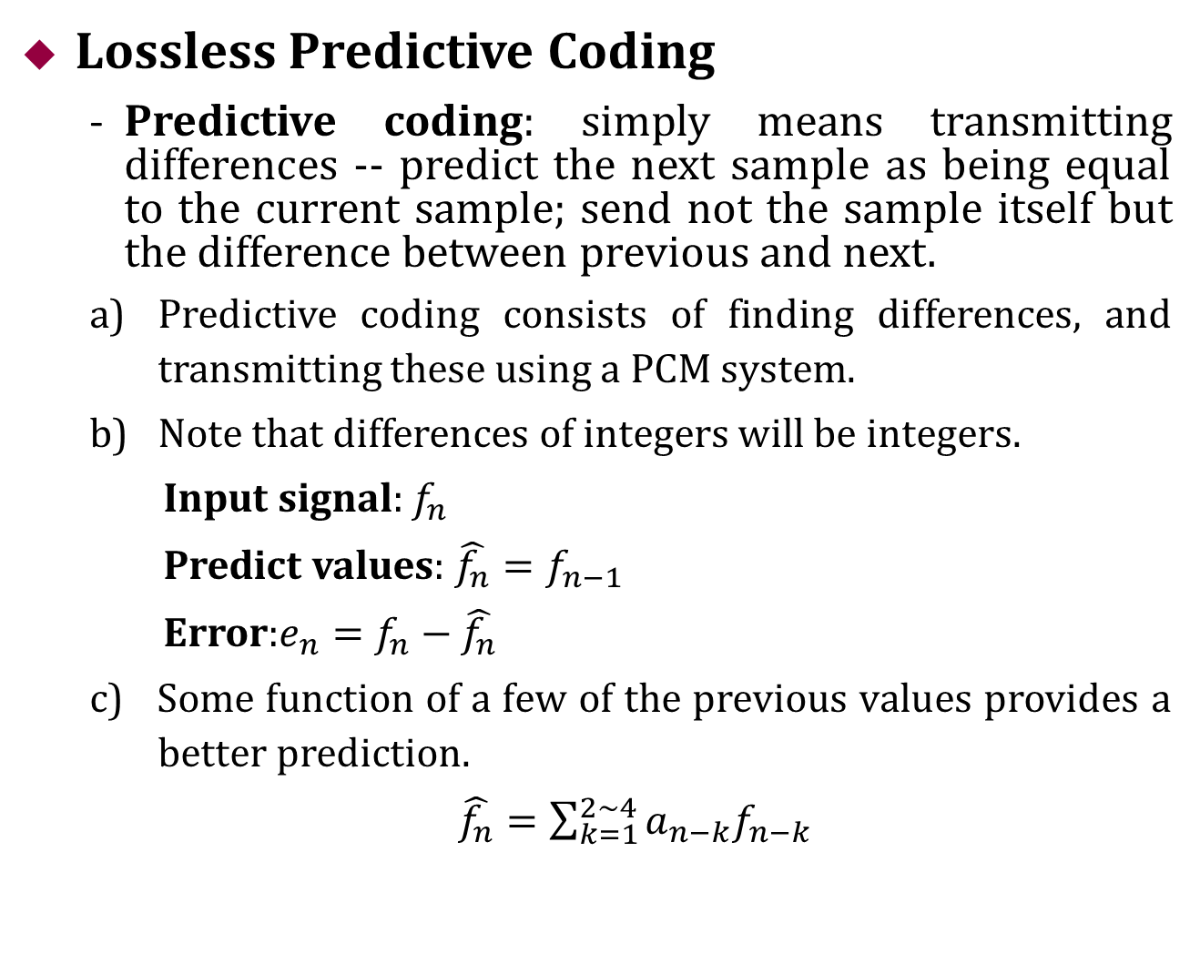
Quantization and Transmission of Audio
Lossless Predictive Coding
Predictive coding: simply means transmitting differences -- predict the next sample as being equal to the current sample; send not the sample itself but the difference between previous and next.
Predictive coding consists of finding differences, and transmitting these using a PCM system.
Note that differences of integers will be integers.
Input signal: $f_{n}$
Predict values: $\hat{f_{n}}=f_{n−1}$
Error:$e_{n}=f_{n}−\hat{f_{n}}$
c) Some function of a few of the previous values provides a better prediction.
$\hat{f_{n}}=\sum_{k=1}^{2\sim 4}{{a_{n−k}f}_{n−k}}$

Slide 22
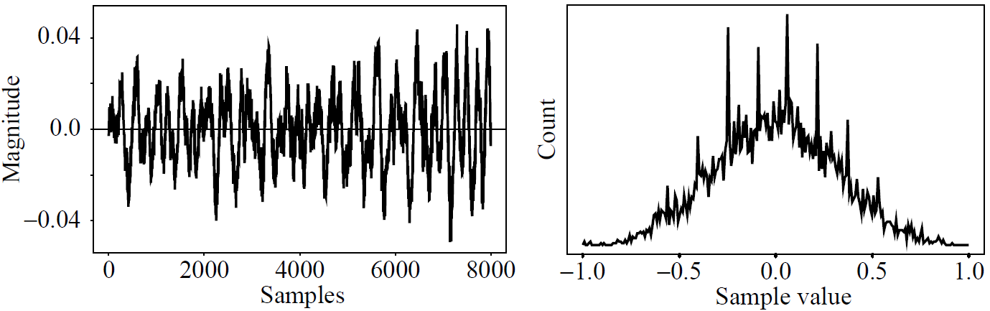
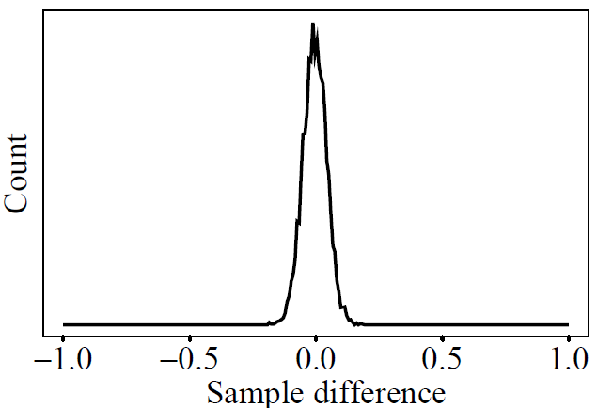
Quantization and Transmission of Audio
Lossless Predictive Coding
The idea of forming differences is to make the histogram of sample values more peaked.
Coding scheme: assigns short codewords to frequently occurring symbols.
Differencing concentrates the histogram.
(a): Digital speech signal.
(b): Histogram of digital speech signal values.
(c): Histogram of digital speech signal differences.

Slide 23

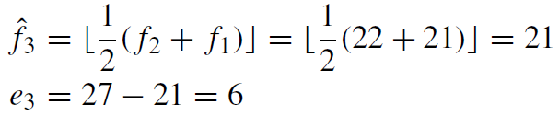
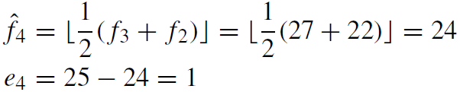
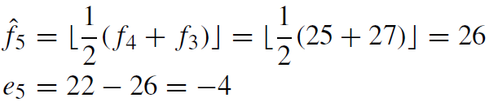
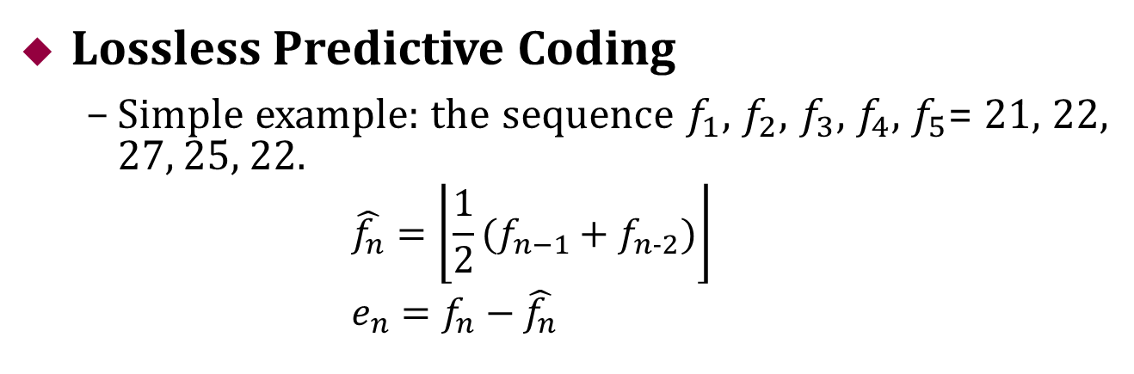
Quantization and Transmission of Audio
Lossless Predictive Coding
Simple example: the sequence $f_{1}$, $f_{2}$, $f_{3}$, $f_{4}$, $f_{5}$= 21, 22, 27, 25, 22.
$$\hat{f_{n}}=\left\lfloor \frac{1}{2}(f_{n−1}+f_{n−2})\right\rfloor \\ e_{n}=f_{n}−\hat{f_{n}}$$
The error does center around zero, we see, and coding will be efficient.

Slide 24
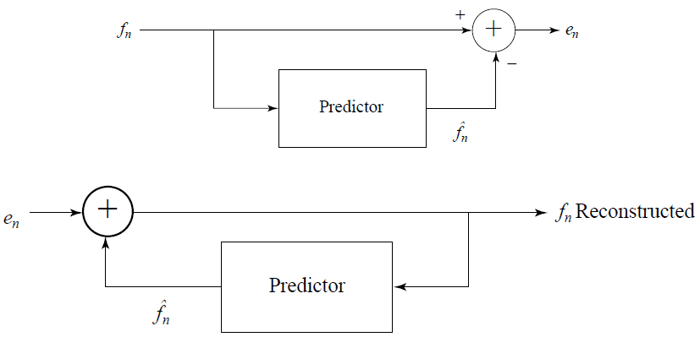

Quantization and Transmission of Audio
Lossless Predictive Coding
Simple example: the sequence $f_{1}$, $f_{2}$, $f_{3}$, $f_{4}$, $f_{5}$= 21, 22, 27, 25, 22.
Schematic diagram for Predictive Coding encoder and decoder.

Slide 25
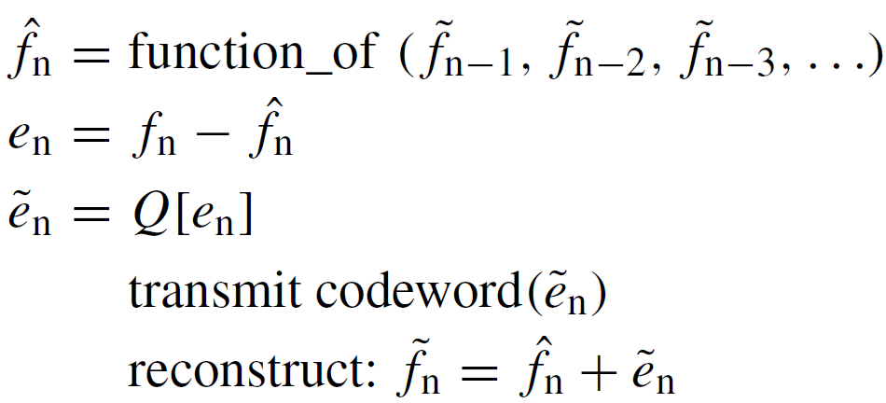
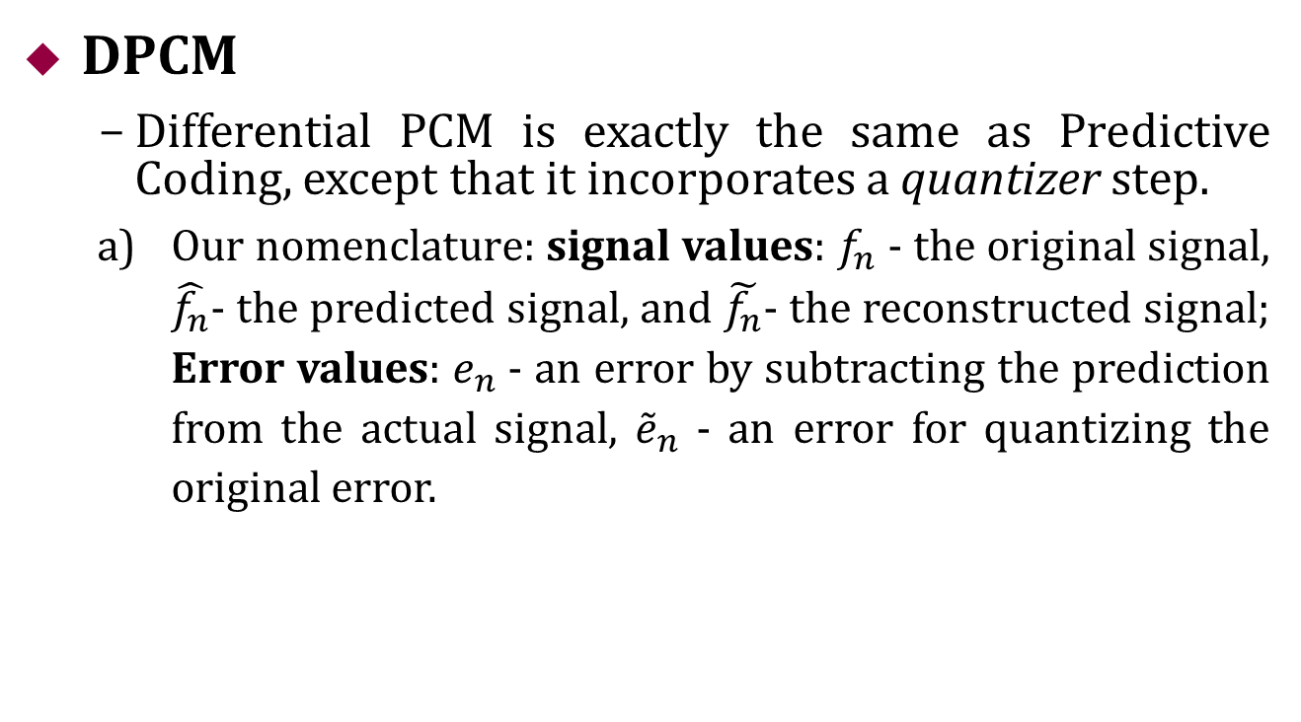
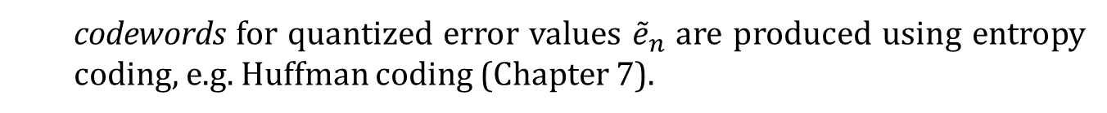
Quantization and Transmission of Audio
DPCM
Differential PCM is exactly the same as Predictive Coding, except that it incorporates a quantizer step.
Our nomenclature: signal values: $f_{n}$- the original signal, $\hat{f_{n}}$- the predicted signal, and $\tilde{f_{n}}$- the reconstructed signal; Error values: $e_{n}$- an error by subtracting the prediction from the actual signal, ${\tilde{e}}_{n}$ - an error for quantizing the original error.
codewords for quantized error values ${\tilde{e}}_{n}$ are produced using entropy coding, e.g. Huffman coding (Chapter 7).

Slide 26
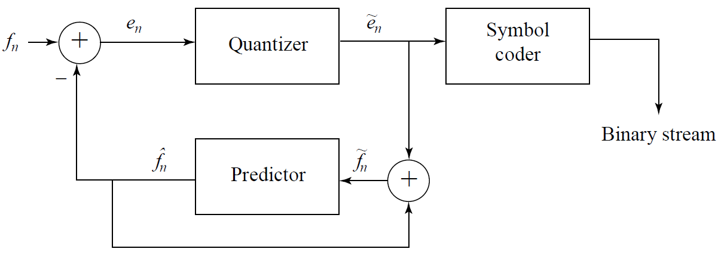
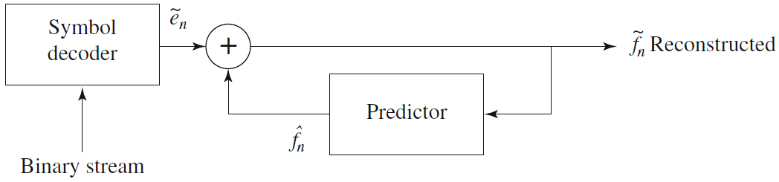
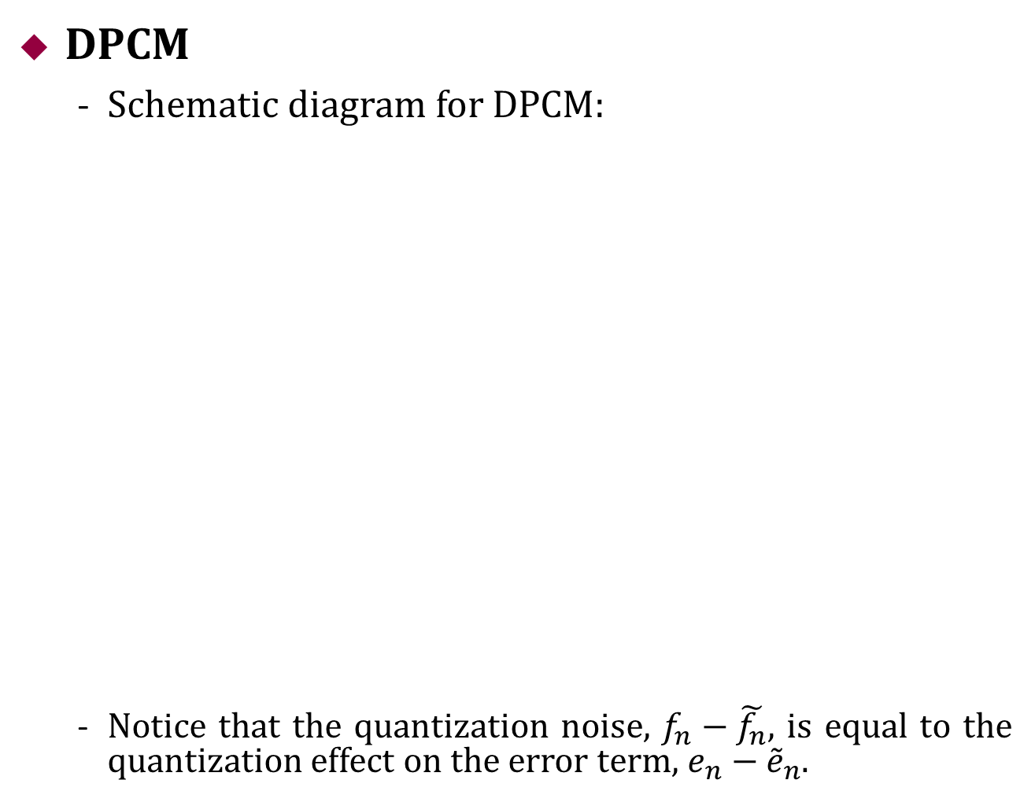
Quantization and Transmission of Audio
DPCM
Schematic diagram for DPCM:
Notice that the quantization noise, $f_{n}−\tilde{f_{n}}$, is equal to the quantization effect on the error term, $e_{n}−{\tilde{e}}_{n}$.

Slide 27
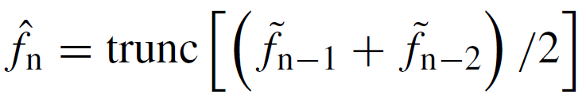
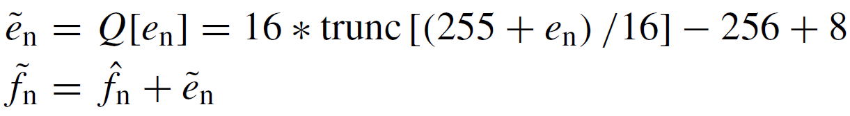
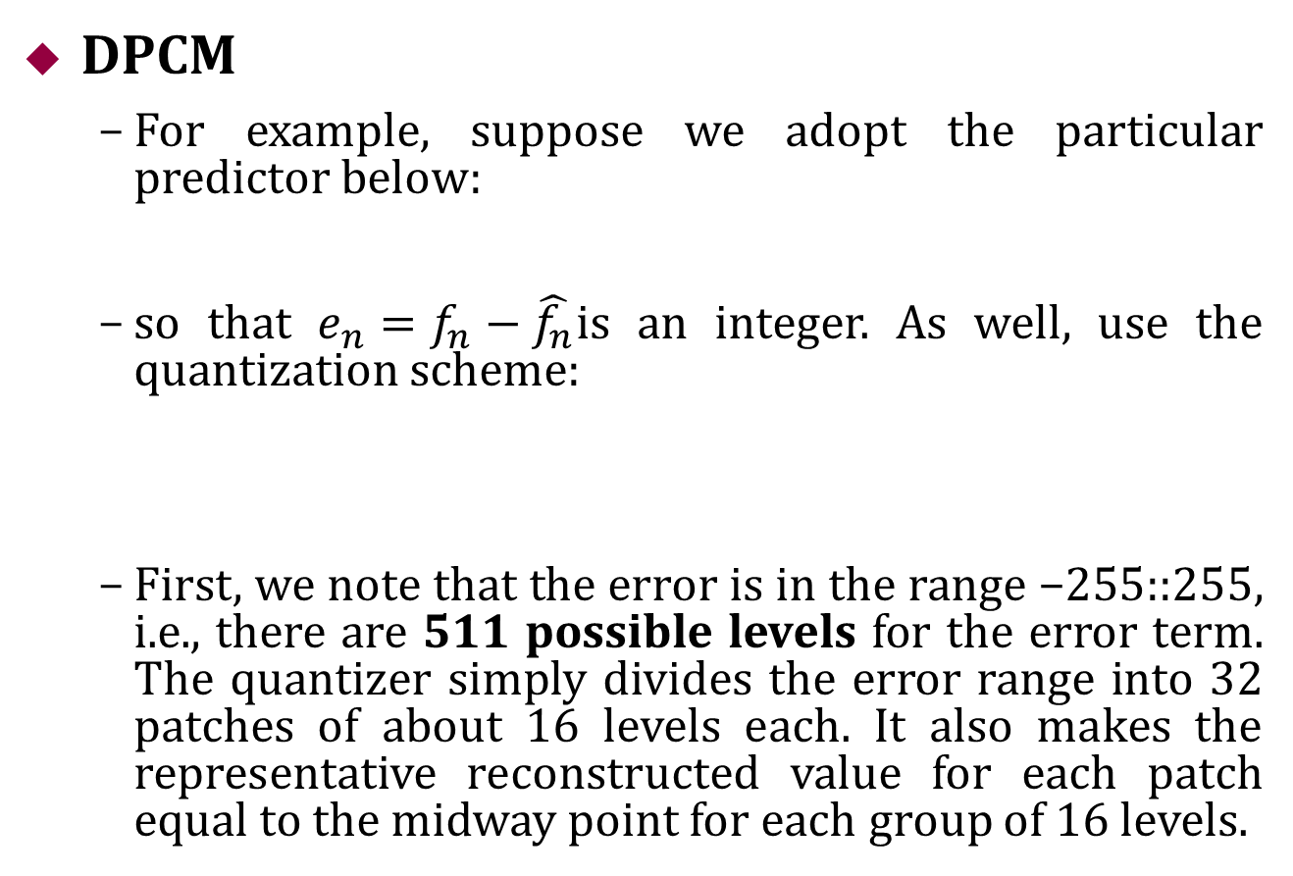
Quantization and Transmission of Audio
DPCM
For example, suppose we adopt the particular predictor below:
so that $e_{n}=f_{n}−\hat{f_{n}}$is an integer. As well, use the quantization scheme:
First, we note that the error is in the range −255::255, i.e., there are 511 possible levels for the error term. The quantizer simply divides the error range into 32 patches of about 16 levels each. It also makes the representative reconstructed value for each patch equal to the midway point for each group of 16 levels.

Slide 28
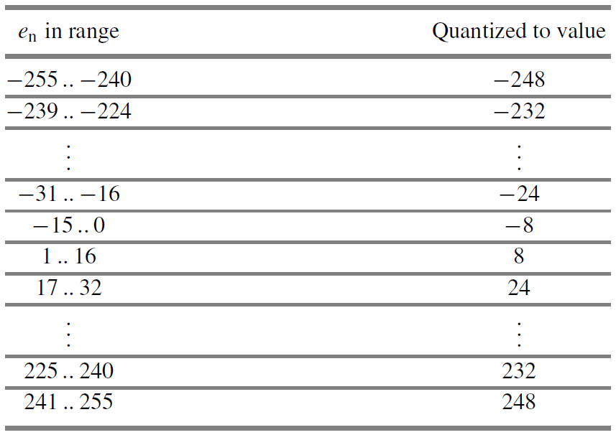
Quantization and Transmission of Audio
DPCM
Table below gives output values for any of the input codes

Slide 29
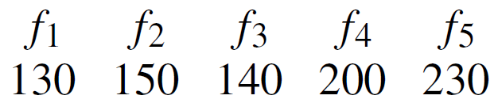
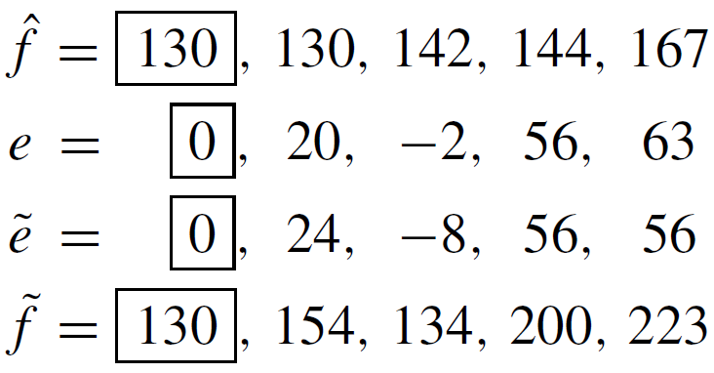
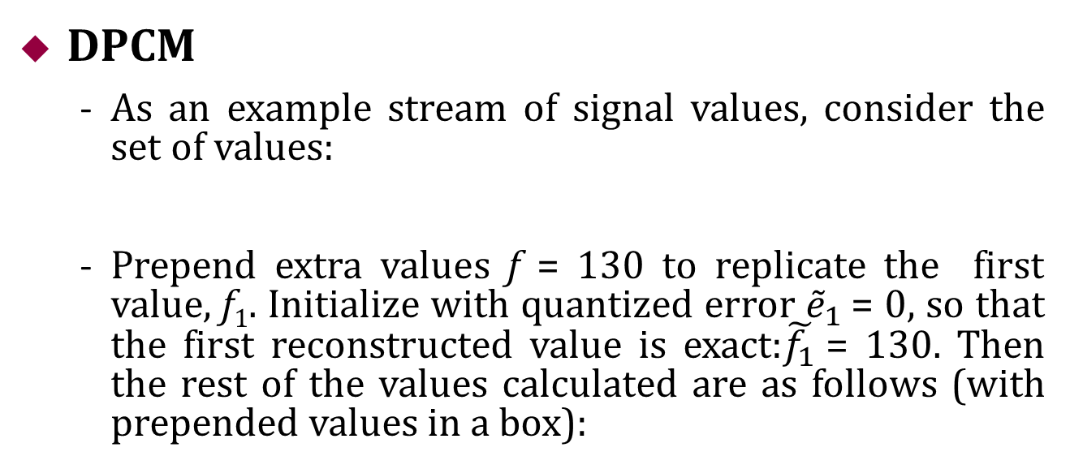
Quantization and Transmission of Audio
DPCM
As an example stream of signal values, consider the set of values:
Prepend extra values f = 130 to replicate the first value, f₁. Initialize with quantized error ${\tilde{e}}_{1}$= 0, so that the first reconstructed value is exact:$\tilde{f_{1}}$= 130. Then the rest of the values calculated are as follows (with prepended values in a box):

Slide 30
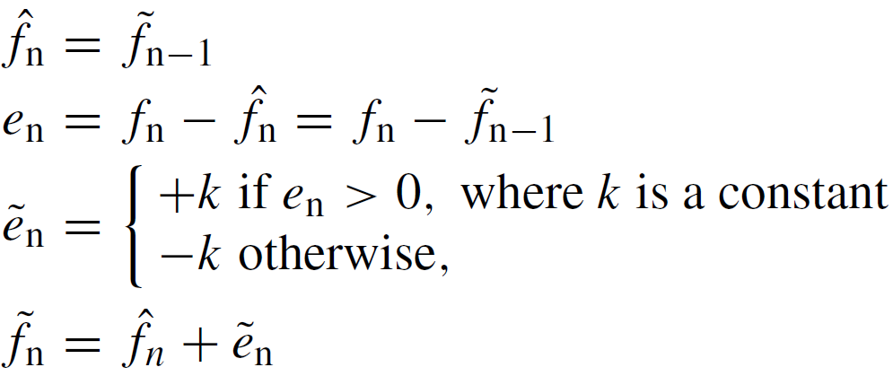
Quantization and Transmission of Audio
DM
DM (Delta Modulation): simplified version of DPCM. Often used as a quick AD converter.
Uniform-Delta DM: use only a single quantized error value, either positive or negative.
a 1-bit coder. Produces coded output that follows the original signal in a staircase fashion. The set of equations is:
Note that the prediction simply involves a delay.

Slide 31
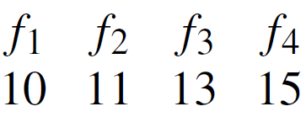
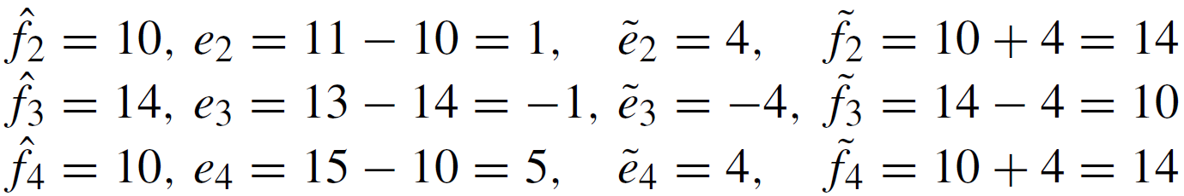
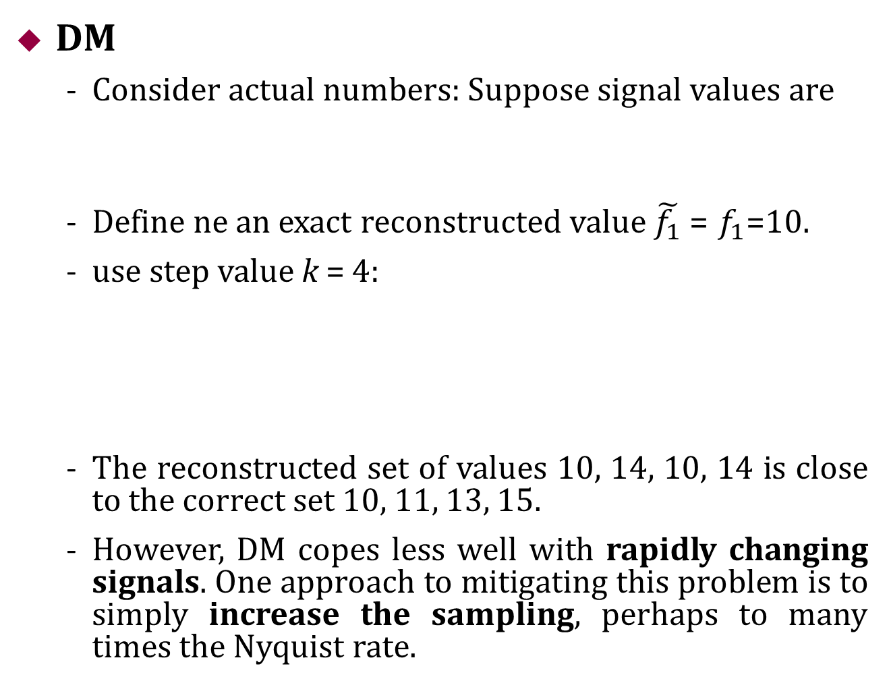
Quantization and Transmission of Audio
DM
Consider actual numbers: Suppose signal values are
Define ne an exact reconstructed value $\tilde{f_{1}}$= $f_{1}$=10.
use step value k = 4:
The reconstructed set of values 10, 14, 10, 14 is close to the correct set 10, 11, 13, 15.
However, DM copes less well with rapidly changing signals. One approach to mitigating this problem is to simply increase the sampling, perhaps to many times the Nyquist rate.

Slide 32
Outline of Lecture 05
Digitization of Sound
Sound and Digitization
Nyquist Theorem
Signal to Noise Ratio (SNR)
Quantization and Transmission of Audio
Experiments

Slide 33
Experiments
Pulse Code Modulation (PCM)
ch06_PCM.m
Differential Pulse Code Modulation (DPCM)
ch06_DPCM.m

